Slide 1
CCF 3100
Fundamentals of PC Security and Privacy
Lecture 2
IT SECURITY CIA TRIANGLE
BY: Dr. DOROTHY CHEGE

Slide 2
Introduction
Information technology is critical to business and society
Computer security is evolving into information security
Information security is the responsibility of every member of an organization, but managers play a critical role

Slide 3
Introduction
Information security involves three distinct communities of interest
  Information security managers and professionals
  Information technology managers and professionals
  Non-technical business managers and professionals

Slide 4
What Is Security?
“The quality or state of being secure—to be free from danger”
Organisational assets: Data, information, network, databases, hardware, software, people
Security is achieved using several strategies simultaneously
Notes:
What Is Security?
Understanding the technical aspects of information security requires that you know the definitions of certain information technology terms and concepts.
In general, security is defined as “the quality or state of being secure—to be free from danger.”
Security is often achieved by means of several strategies usually undertaken simultaneously or used in combination with one another.

Slide 5
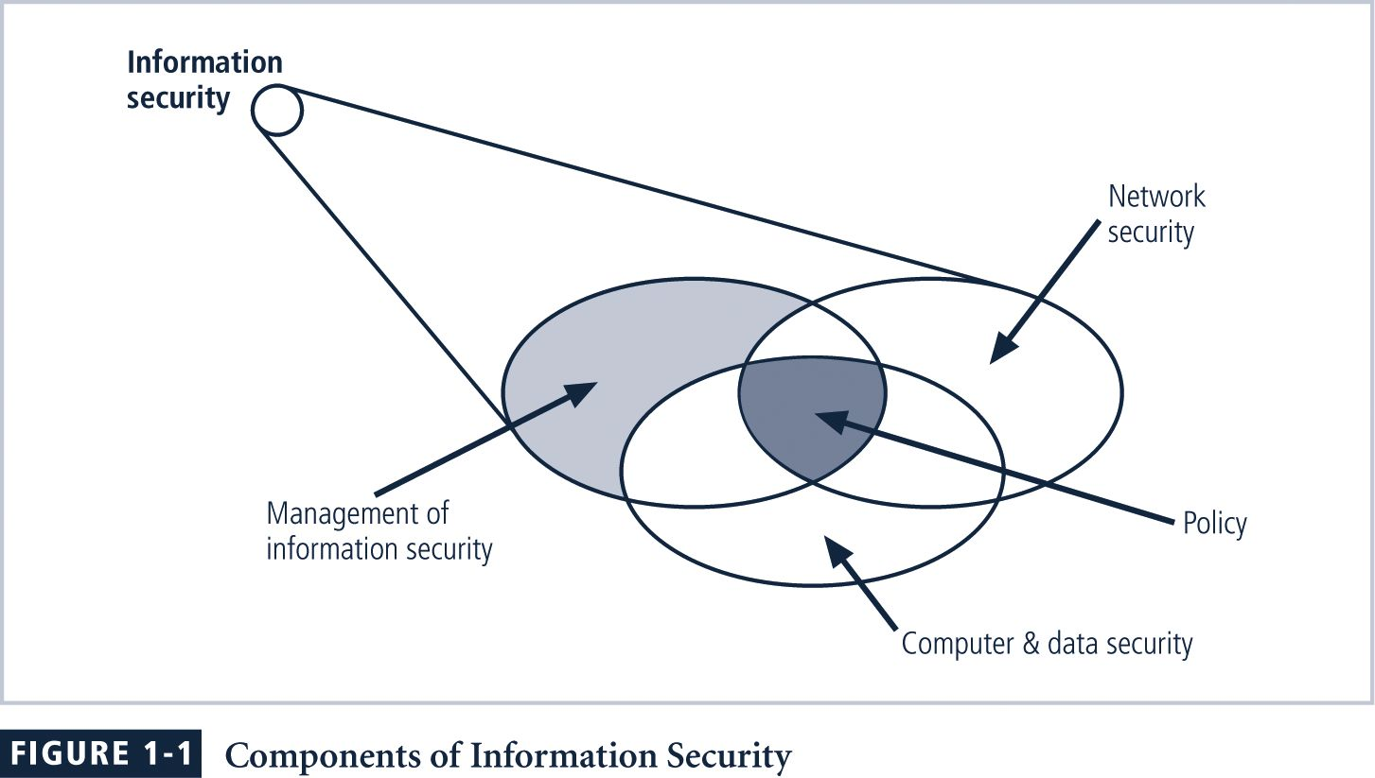
InfoSec Components
Notes:
FIGURE 1-1 Components of Information Security
Information security (InfoSec) is the protection of information and its critical elements, including the systems and hardware that use, store, and transmit that information.
Figure 1-1 shows that information security includes the broad areas of information security management (the topic of this book), computer and data security, and network security. At the heart of the study of information security is the concept of policy (discussed in detail in Chapter 4). Policy, awareness, training, education, and technology
are vital concepts for the protection of information and for keeping information systems from danger.

Slide 6
CIA Triangle / TRIAD
The C.I.A. triangle is made up of
  Confidentiality
  Integrity
  Availability
Over time the list of characteristics has expanded, but these three remain central
CNSS model is based on CIA

Slide 7
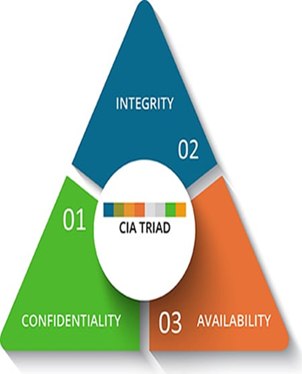
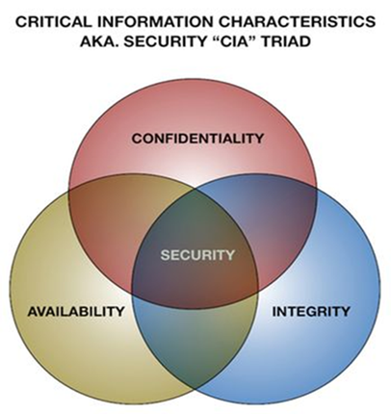
CIA SECURITY MODEL TRIANGLE / TRIAND
OR

Slide 8
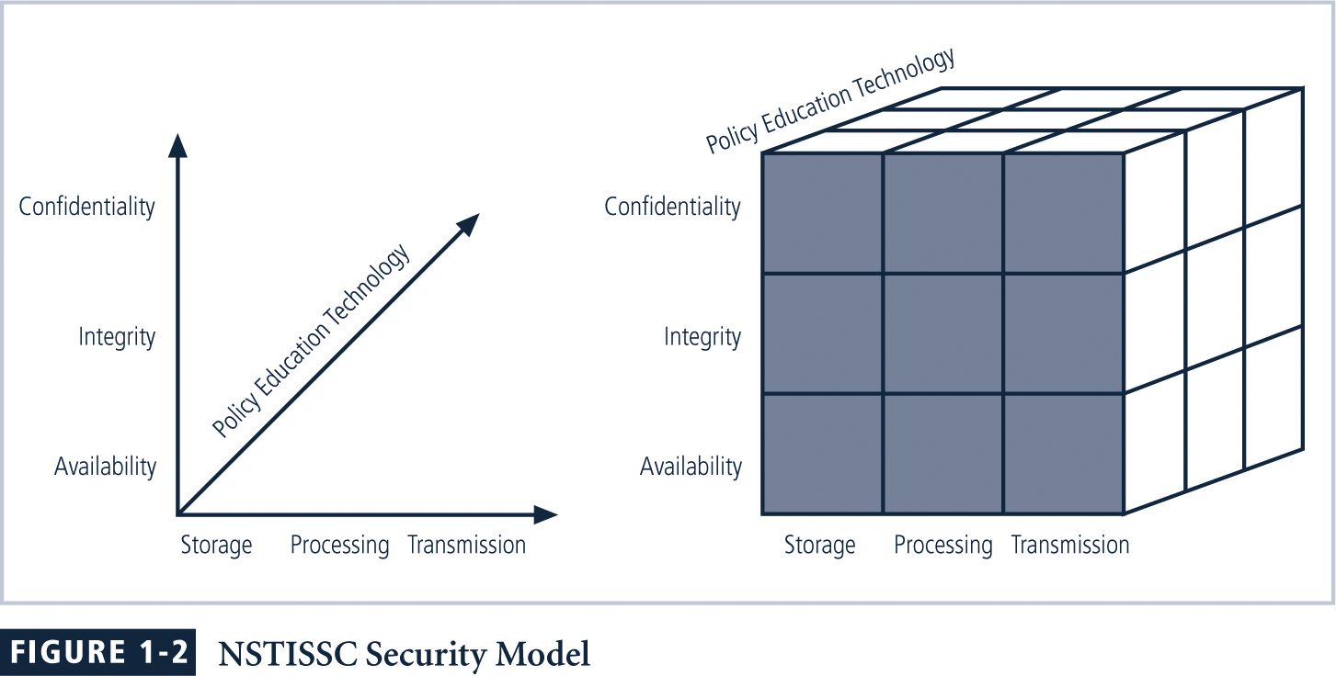
NSTISSC Security Model (4011)
Notes:
Figure 1-2 NSTISSC Security Model
The NSTISSC security model, as shown in Figure 1-2, illustrates three dimensions central to the discussion of information security. If we extend the relationship among the three dimensions represented by the axes, we end up with a 3 × 3 × 3 cube with 27 cells. Each of these cells represents an area of intersection among these three dimensions that must be addressed to secure information systems. When using this model to design or review any information security program, you must make sure that each of the 27 cells is properly addressed by each of the three communities of interest.

Slide 9
Key Concepts: Confidentiality
Confidentiality
  Only those with sufficient privileges may access certain information
Confidentiality model
  Bell-LaPadula
    No write down & No read up
  Chinese Wall model
  TCSEC/TNI (Orange, Red Book)
Some threats
  Hackers
  Masqueraders
  Unauthorized users
  Unprotected download of files
  LANS
  Trojan horses

Slide 10
Key Concepts: Integrity
Integrity
  Integrity is the quality or state of being whole, complete, and uncorrupted
Integrity model
  Biba/low water mark
    No write up & No read down
  Clark-Wilson
    Separation of duty
  Lipner
Other issues
  Origin integrity
  Data integrity
  Threats
  Human Error
  Malware
  Insider threats
  Cyberattacks

Slide 11
Key Concepts: Availability
Availability
  Making information accessible to user access without interference or obstruction
  Threats:
  DOS
  DDOS
  Malware

Slide 12
Other Security Concepts
Survivability
  Ensuring availability in presence of attacks
Privacy
  Information is to be used only for purposes known to the data owner
  This does not focus on freedom from observation, but rather that information will be used only in ways known to the owner

Slide 13
Other Security Concepts: Identification
Identification
  Information systems possess the characteristic of identification when they are able to recognize individual users
  Identification and authentication are essential to establishing the level of access or authorization that an individual is granted

Slide 14
Other Security Concepts:
Authentication & Authorization
Authentication
  Authentication occurs when a control provides proof that a user possesses the identity that he or she claims
Authorization
  Authorization provides assurance that the user has been specifically and explicitly authorized by the proper authority to access the contents of an information asset

Slide 15
Other Security Concepts:
Accountability; Assurance
Accountability
  The characteristic of accountability exists when a control provides assurance that every activity undertaken can be attributed to a named person or automated process
Assurance
  Assurance that all security objectives are met

Slide 16
Questions???
Class Exercise:
Read and make short notes on:
  Confidentiality models: Bell LaPadula and Chinese Wall Models
  Integrity Models: Biba and Clark-Wilson Models
  Access the following Link for extra lecture notes:
    https://www.tutorialspoint.com/computer_security/computer_security_pdf_version.htm

